Slide 1


LIBRARY MANAGEMENT SYSTEM
ANILA K

Slide 2
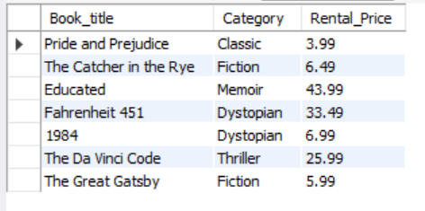
1. Retrieve the book title, category, and rental price of all available books

Slide 3
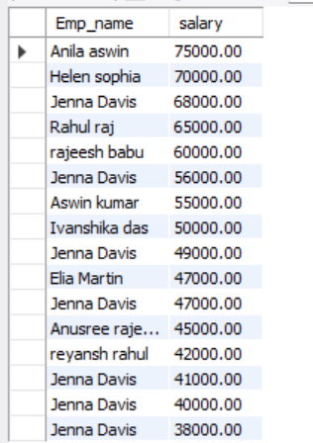
2. List the employee names and their respective salaries in descending order of salary.

Slide 4
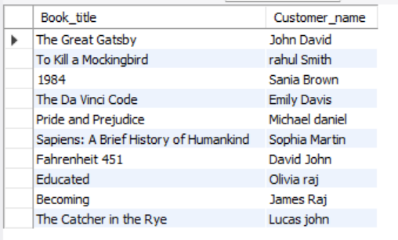
3. Retrieve the book titles and the corresponding customers who have issued those books.

Slide 5
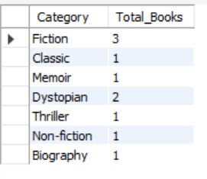
4. Display the total count of books in each category.

Slide 6
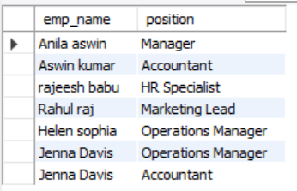
5. Retrieve the employee names and their positions for the employees whose salaries are above Rs.50,000.

Slide 7
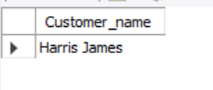
6. List the customer names who registered before 2022-01-01 and have not issued any books yet.

Slide 8
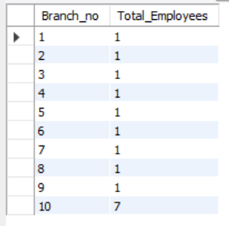
7. Display the branch numbers and the total count of employees in each branch.

Slide 9

8. Display the names of customers who have issued books in the month of June 2023.

Slide 10

9. Retrieve book_title from book table containing history.

Slide 11
10.Retrieve the branch numbers along with the count of employees for branches having more than 5 employees

Slide 12

11. Retrieve the names of employees who manage branches and their respective branch addresses.

Slide 13
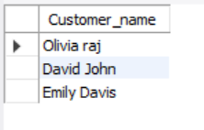
12. Display the names of customers who have issued books with a rental price higher than Rs. 25.

Slide 14
THANK YOU

